Slide 1
Java Servlets

Slide 2
Servlet
A Servlet is a Server Side Java Program, which accepts request from Web Browser(Client), processes the request, and sends the response(generally HTML code) back to the Client.
A WebServer is required to a run a servlet.
Below are some examples of Web Server.
Apache Tomcat
Glass Fish Server,etc..
Web Logic
Web Sphere

Slide 3
Web Server
HTML/CSS/JavaScript Executes here
1.HTTP Request
2. Processing
Web Browser(Client)
HttpServletRequest
Java Servlet
HttpServletResponse
3.HTTP Response
Internet/LAN
Database
NOTE:
HTTP Request has all data entered by user on webpage
HTTP Request has HTML/CSS/JavaScript to display next web page

Slide 4
How to develop a Servlet?
1. The package javax.servlet need to be imported.
2. A Servlet program is generally extended from javax.servlet.http.HttpServlet class.
3. Then override any or both of the methods
doGet() – to support HTTP GET Requests
doPost() – to support HTTP POST Requests
NOTE: Both above methods have two parameters
HttpServletRequest – object of this class has all data submitted from Web Browser
HttpServletResponse – response from Servlet is sent to Web Browser, by putting in this object.
Both above methods throws ServletException, IOException

Slide 5
As shown in the diagram, a Servlet receives request from Web Browser, processes the request, and may even connect to database, to query or update data. For example consider a simple scenario, in which user Logs in to a web site.
Browser displays Login web page
User fills up username/password, and clicks “Login” button
Now Web Browser sends HTTP Request to Web Server, whose URL is provided thru action attribute in <form> tag
The HTTP request is received by the Servlet, which retrieves username and password from the request.
Now Servlet checks, if username/pwd are valid, by querying to database.
Then Servlet sends appropriate HTTP response web page, back to Web Browser.

Slide 6
Deployment Descriptor
Web.xml is deployment Descriptor, which has list of Servlet classes, initialization parameters, etc..
Web server gets the details of Servlet thru web.xml
web.xml also provides mapping between a url and specific Servlet class. So, when web server receives request with a specific url, corresponding servlet class gets executed.
http://localhost:8080/ServletExample/NewServlet
Request URL to a Servlet
protocol
Folder name on server
Domain name
Port number(is required only if server is running on non standard port number
Servlet name

Slide 7
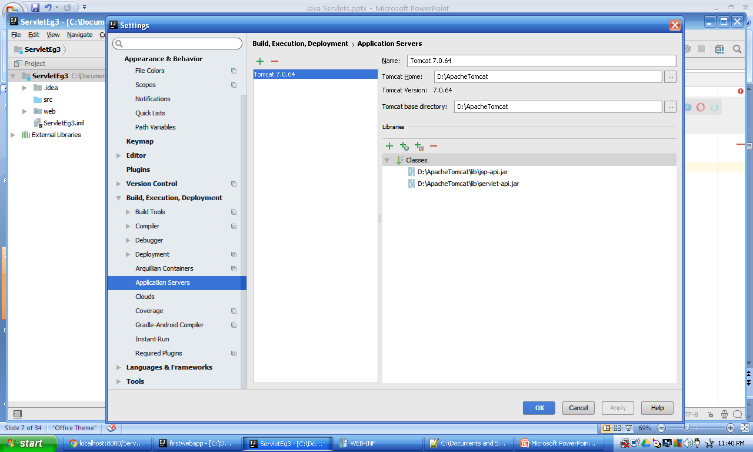
How to add WebServer to Intellij

Slide 8
Servlet Life Cycle
Below are life cycle methods of a Servlet
init(ServletConfig config) – gets invoked only once, when first request is being received by Server.
service() – this method further invokes doGet() or doPost() – Get invoked once, for every request
destroy() – gets invoked only when
(a) server is shutdown or
(b) when server is out of memory or
(c) when no requests are received for certain period of time. After destroy() gets invoked Servlet no more exists in memory. Again when a new request is received, init( ) gets invoked.

Slide 9
GenericServlet
init() and destroy()
HttpServlet
service(), doGet(), doPost()
HTTP Protocol specific Base Servlet class
HelloServlet
Servlet developed by us

Slide 10
Servlet Initialization parameters
Any configurable parameters can be provided to web application thru initialization parameters in web.xml
There are two types of initialization parameters.
Servlet specific: These init params can be accessed only by a specific servlet. ServletConfig can be used to retrieve servlet specific init parameter values, from web.xml
Web app specific: These init params can be accessed by any servlet within the web application. Here ServletContext is used to retrieve web app specific init params from web.xml

Slide 11
Since HTTP protocol does not maintain any session, we have to maintain session related details using server side program. A Session has user specific details, when user interaction with web site is under progress.There are two ways to maintain session related details.
Cookie
HTTPSession
Servlet Cookie
A Cookie is a small piece of information which a server side program(such as Java Servlet) can store and retrieve, to and from Browser. Cookie is persistently stored in Browser, until expiry.
A Cookie has
Name
Value(only plain text allowed)
Expiry date/time
Disadvantages of Cookies are:
Cookies can be viewed or may be edited by User
Cookies can be deleted by User

Slide 12
Servlet Filter
A filter is an object that is invoked at the preprocessing and postprocessing of a request from and to Browser.
It is mainly used to perform filtering tasks such as conversion, logging, compression, encryption and decryption, input validation etc.
The servlet filter is dynamically pluggable, i.e. its entry is defined in the web.xml(Deployment Descriptor) file, if we remove the entry of filter from the web.xml file, filter will be removed automatically and we don't need to change the servlet.
i..e no recompilation and deployment of webapplication is required
Hence, maintenance cost is less

Slide 13
Web Server
Preprocessing a Request
F
I
L
T
E
R
Web Browser(Client)
1.Request
2
Java Servlet
4.Response
3
Post processing a Response

Slide 14
Web Server
There can be Filter chains, as shown below
F
I
L
T
E
R
1
F
I
L
T
E
R
2
F
I
L
T
E
R
3
Java Servlet
Web Browser(Client)

Slide 15
HttpSession
HTTP is the protocol used between Browser and Web Server. A session stores user specific details, for a period for which user is logged in to the site. Since HTTP Protocol is state less, it is the responsibility of server side program(like Java Servlets, JSP) to maintain Session details, when a session is in progress between Browser and Web Server.
Generally session stores user specific details, like the user who is currently logged in, etc…
A Servlet can
Create a new session(this is done, generally when user logs in)
Retrieve an existing session
Set, Get or remove an attribute to and from a session
Destroy a Session(this is done, when user logs out)

Slide 16
Usage of Filter
recording all incoming requests
logs the IP addresses of the computers from which the requests originate
Can block requests from certain IP addr or range of IP addresses.
conversion
data compression
encryption and decryption
input validation etc.
Advantage of Filter
Filter is pluggable.
Gets invoked only for matching url-pattern configured in web.xml
One filter don't have dependency onto another resource.
Less Maintenance

Slide 17
Another Advantage of Filters is, it is possible to have multiple Filters at a time, each Filter can be plugged out or plugged in(just by changing web.xml) based on the requirement.

Slide 18
RequestDispatcher: When processing a request, a Servlet may need to
forward the request to some other resource
Include output of some other resource to the current one.
RequestDispatcher provides methods to forward or include a resource.

Slide 19
RequestDispatcher Forward
NOTE: any response from Processing Servlet is discarded
3.Forward the request to some other Servlet
2. Processing Servlet
4.Forwarded Resource
1. Send HTTP Request to Servlet
Web Browser (Client)
5.Send the response to Client
…
Web Server

Slide 20
RequestDispatcher Include
3.Include request to some other Servlet
2.Processing Servlet
4.Included Resource
1.Send HTTP Request to Servlet
Web Browser (Client)
5. response from Processing Servlet is included along with included resources
NOTE: Any number of resources can be included. Responses from all the resources is included along with response from Pro cessing Servlet

Slide 21
Redirect
2. Processing Servlet
5.Forwarded Resource
1. Send HTTP Request to Servlet
3.Send redirect request back to Browser
4.Send the request to forwarded resource
Web Browser (Client)
…
6.Response from forwarded resource
Web Server
Redirect with HTTP Post method:
response.setStatus(307); //this makes the redirection keep your requesting method as is. response.addHeader("Location", "http://address.to/redirect");

Slide 22
Session data
Get existing session
Get existing session
getSession(false)
getSession(false)
setAttribute()
getAttribute()
Invalidate() destroys the session
getAttribute()
getSession()
Create new session
Web Browser (Client)
Login Servlet
Servlet1
Servlet2
Logout Servlet
…
…
…
HTTP
Web Server

Slide 23
JSP
JSP stands for Java Server Pages. JSP is just an extension over Servlets. Advantages of JSP over Servlets are
JSP Code is more compact compared to Servlets
JSP is tag based, and syntactically looks similar to HTML, and has better readability.
Development time of Web Applications using JSP is lesser compared with that of Servlets.
Note that when .jsp is built, Servlet Java file gets generated behind the scenes. Further .class file is generated from .java Servlet file. And JVM finally executes the .class file on the Web Server, during run time.
JSP execution may be slower compared to a Servlet.

Slide 24
JSP Tags
JSP is Tag based, and below are most frequently used tags in JSP
<%! declaration tag %>
<% scriplet Tag %>
<%= expression tag %>
<%-- comment --%>
<%@ directive tag %>
Declaration Tag: All variable declarations need to be enclosed in Declaration Tag Eg. <%! int a,b; %>
Scriplet Tag: All other normal code need to be enclosed in Scriplet Tag.
Expression Tag: any expression gets evaluated and output is sent as response Eg. <%= (a+b) %>
Comment Tag: JSP Comment are enclosed
Directive Tag: used to import, session, exception handling,etc…

Slide 25
JSP Tags
In each JSP file, there can be any number of each of above JSP Tags.
Usages of <%@ directive tag %>
To import package(s)
To manage session
To specify taglib
To handle exceptions

Slide 26
JSP Implicit objects
In JSP implicit objects are the objects created by implicitly, and can be directly used in Jsp programs with out declaring them. This is basically to reduce the code written by developer.
Below is list of Jsp implicit objects, along with the details
Implicit object name | Class name | Details
request | HTTPServletRequest | Request received from client
response | HTTPServletResponse | Response which need to be sent to client
out | PrintWriter
config | ServletConfig | Used to retrieve init parameters
application | ServletContext | Used to retrieve application wide init parameters
session | HttpSession | Indicates a session created between client and server
exception | ServletException
pageContext
page

Slide 27
JSP Forward and Include
<jsp:forward />
JSP Tag used to forward the request to some other resource.
<jsp:include />
JSP Tag used to include request of some other resource, to the response of currently processing JSP.
Note that, <jsp:param name=“var1” value=“test” /> can be used with either of them to send additional parameters and values to forwarded or included resource

Slide 28
JSP Life Cycle
Below are the JSP Life Cycle methods,
jspInit() is called only once , when first request is received by JSP page. Any one time initialization code can be added to jspInit().
_jspService() is called once for every request. This method is not written by Developer, it gets generated.
jspDestroy() is called, when JSP instance gets destroyed due to any of below reasons
a) When Web Server is shutdown.
b) When Server is out of memory.
c) When requests are not received, for certain amount of time i..e when timeout occurs.
Any
//jspInit() is not invoked for every request
<%!
public void jspInit(){
System.out.print("jspinit");
}
%>
<%!
public void jspDestroy(){
System.out.print("jspdestroy");
}
%>

Slide 29
JSTL
JSTL stands for Java Server Pages Template Library. For more frequently required functionality, JSP provides additional Tags as part of JSTL. JSTL is divided into belwo Categories.
1.Core - loop, choose/when, etc…
<%@ taglib uri="http://java.sun.com/jsp/jstl/core" prefix="c" %>
Scope of variables
2.XML – to parse XML files, retrieve values of various elements
<%@ taglib prefix="x" uri="http://java.sun.com/jsp/jstl/xml" %>
3.Format
<%@ taglib uri="http://java.sun.com/jsp/jstl/fmt" prefix="fmt" %>
4.SQL – provides JSP Tags, to connect to database, retrieve rows/records. This code is more compact compared to using JDBC to connect to database.
<%@ taglib uri="http://java.sun.com/jsp/jstl/sql" prefix="sql"%>
Note: Any prefix can be used, but tags from corresponding taglib need to be prefixed, accordingly.
Also note that it is possible to develop our own JSP Tags, just like JSTL

Slide 30
Index page
When an HTTP client (generally a web browser) requests a URL that points to a directory structure instead of an actual web page within the directory, the web server will generally serve a default page, which is often referred to as a main or "index" page, like index.html or index.jsp or index.php, etc…

Slide 31
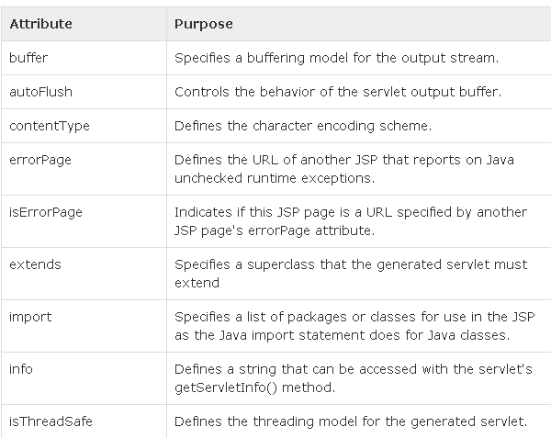
JSP page attributes

Slide 32
page directives examples
<%@ page buffer="none" %>
<%@ page buffer=“6kb" %>
<%@ page autoFlush="true" %>
<%@ page extends=“myackage.MyClass" %>
<%@ page isThreadSafe="false" %>

Slide 33
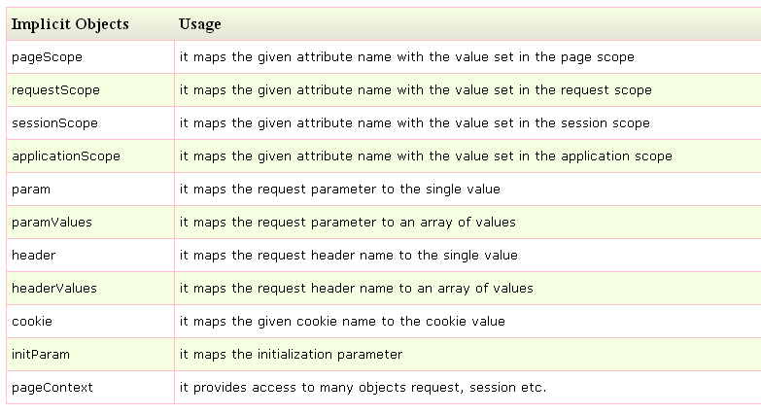
JSP Expression Language
JSP Expression Language (EL) simplifies the accessibility of data stored in objects like request, session, application etc.
Syntax for Expression Language (EL)
${ expression }

Slide 34
index.jsp
<form action=“login.jsp">
Enter Name:<input type="text" name=“username" /><br/><br/>
<input type="submit" value="go"/>
</form>
login.jsp
Welcome, ${ param.username }

